Slide 1
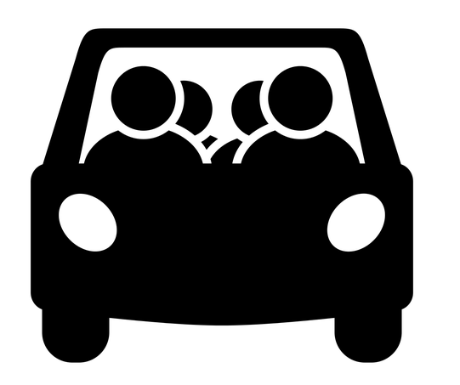




Missouri Commuter Analysis
Martin Carriel, Addison Pietroburgo, Joshua Steinmetz, Scott Stevener
Washington University Data Analytics Boot Camp
Fall 2018

Slide 2
Motivation & Summary
Hypotheses
  H0 = No differences exist between commuting types in metro versus rural counties across Missouri.
  H1 = Differences exist between commuting types in metro versus rural counties across Missouri, where usage of public transit in metro counties is higher.
Questions asked (and why you asked them?)
  How do Missourians commute?
  What differences exist for commuting types across counties in Missouri?
  What differences exist for commuting types within metropolitan areas in Missouri?
(Describe whether you were able to answer these questions to your satisfaction, and briefly summarize your findings)

Slide 3
Questions & Data
What kinds of data were needed?
  How do Missourians commute?
  What differences exist for commuting types across counties in Missouri?
  What differences exist for commuting types within metropolitan areas in Missouri?
Data sources
  US Census API
  Wikipedia
  Wikilou.com
  MARC.org (Mid-America Regional Council)

Slide 4
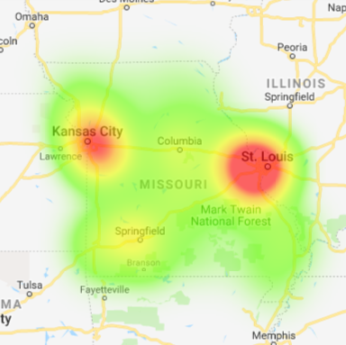
Data Exploration & Cleanup
Used census wrapper to make API calls to get commute data for each county in MO
Calculated commute type %s
Made calls to the Google Maps Geocode API to get coordinates for each county
Created heat map of commuter concentrations
Looked up counties in STL, KC and Springfield Metro Areas & repeated process for counties outside of MO

Slide 5
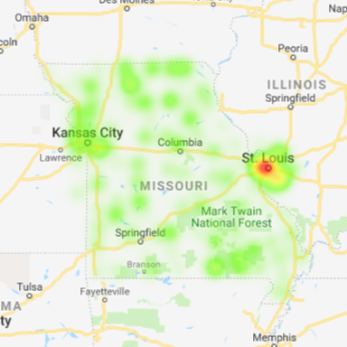
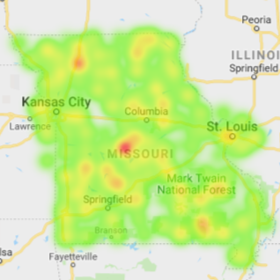
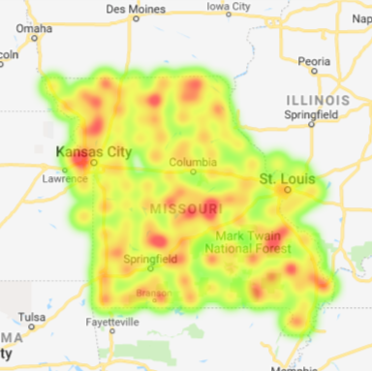
Data Analysis: Commute Type Concentrations in MO
Carpooler %
(max. 19%)
- Kansas City
- Jefferson City
- Farmington
Public Transit %
(max. 10%)
- St. Louis
Other Transit %
(max. 5%)
- Ozarks

Slide 6
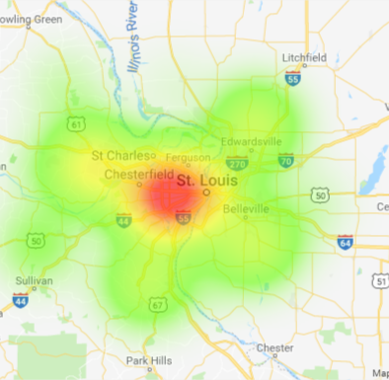
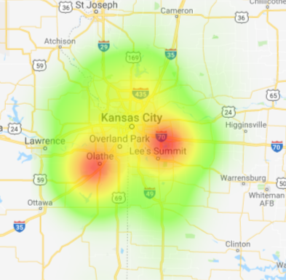
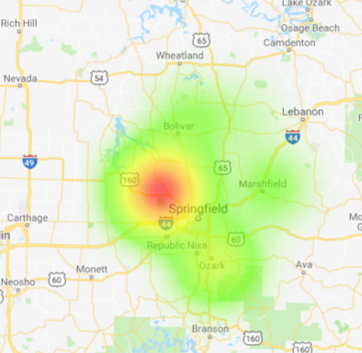
Data Analysis: MO Metro Comparisons -
Commuter Concentrations

Slide 7
Discussion
Discuss your findings.
Did you find what you expected to find? If not, why not?
What inferences or general conclusions can you draw from your analysis?
  Driving to work alone is seem as the best option by the overwhelming majority of commuters.
  Commuters do not have commuting options other than solo commuting.
  Commuters do not see options other than solo commuting as a viable way to get to work.
  The option to use public transit exists mainly in urban areas.
  Even in urban areas where public transit is available, Missourians do not use it for commuting.

Slide 8
Post Mortem
Discuss any difficulties that arose, and how you dealt with them
Discuss any additional questions that came up, but which you didn't have time to answer: What would you research next, if you had two more weeks?
  Analysis of other State’s commuting data to look for similarities/differences, specifically those in different geographies, with urban/rural ratio, larger metros
  Additional analysis into Income Levels and Commuting Types.
  Why are we seeing concentrations of Walkers in northern Missouri?

Slide 9
Questions?

Slide 11
Definition of Commuting
Census surveys define Commuting (Journey to Work) as “a worker’s travel from home to work”.
Census surveys ask questions about Commuting such as travel time, means of transportation, time of departure for work, vehicles available, and expenses associated with the commute.
For this analysis we looked only at means of transportation

Slide 12
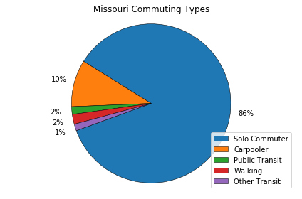
Statewide Analysis

Slide 13
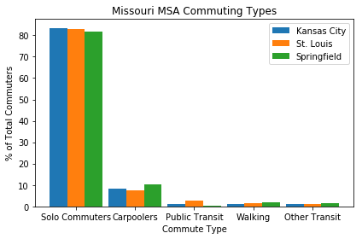
MSA Analysis

Slide 14
Hypotheses
H0 = No differences exist between commuting types in metro versus rural counties across Missouri.
H1 = Differences exist between commuting types in metro versus rural counties across Missouri, where usage of public transit in metro counties is higher.

Slide 15
What we wanted to understand
How do Missourians commute?
What differences exist for commuting types across counties in Missouri?
What differences exist for commuting types within metropolitan areas in Missouri?

Slide 16
MSAs Analyzed
St. Louis
St. Louis City, MO
St. Louis County, MO
St. Charles County, MO
Jefferson County, MO
Franklin County, MO
Lincoln County, MO
Warren County, MO
Madison County, IL
St. Clair County, IL
Clinton County, IL
Monroe County, IL
Jersey County, IL
Kansas City
Bates County, MO
Caldwell County, MO
Cass County, MO
Clay County, MO
Clinton County, MO
Jackson County, MO
Lafayette County, MO
Platte County, MO
Ray County, MO
Johnson County, KS
Leavenworth County, KS
Linn County, KS
Miami County, KS
Wyandotte County, KS
Springfield
Greene County, MO
Christian County, MO
Webster County, MO
Polk County, MO
Dallas County, MO

Slide 18
Solo Commuters

Slide 19
Carpoolers

Slide 20
Public Transit

Slide 21
Walking

Slide 22

Other Transit

